Slide 1
Rules of Handicapping
John Pavlak
Notes:
Please use this title slide if you do not plan to co-brand it.
Welcome and Introductions
• Welcome everyone
• Introduce yourself and the other instructors if applicable
• Invite attendees to ask questions.

Slide 2
Topics We Will Cover
The World Handicap System
Fundamentals of Handicapping
New Terminology
Course Handicap Calculation
Playing Handicap
Score Posting Changes
Maximum Hole Score for Posting
Most Likely Score
Time for Posting
Frequency of Handicap Updates
Handicap Index Formula
Handicap & Tournament Committees
Questions

Slide 3
Welcome to the WHS

Slide 4
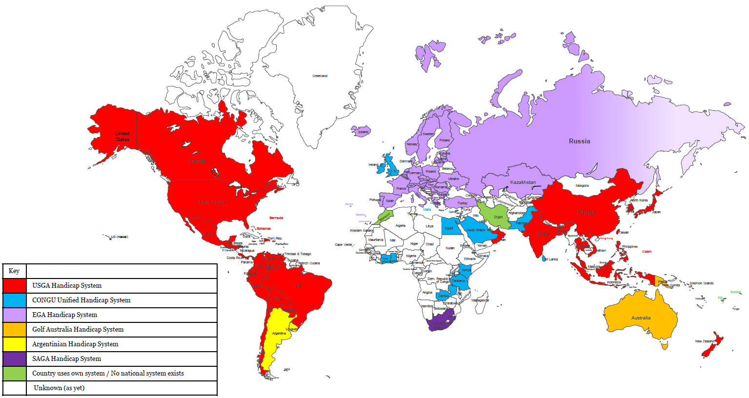
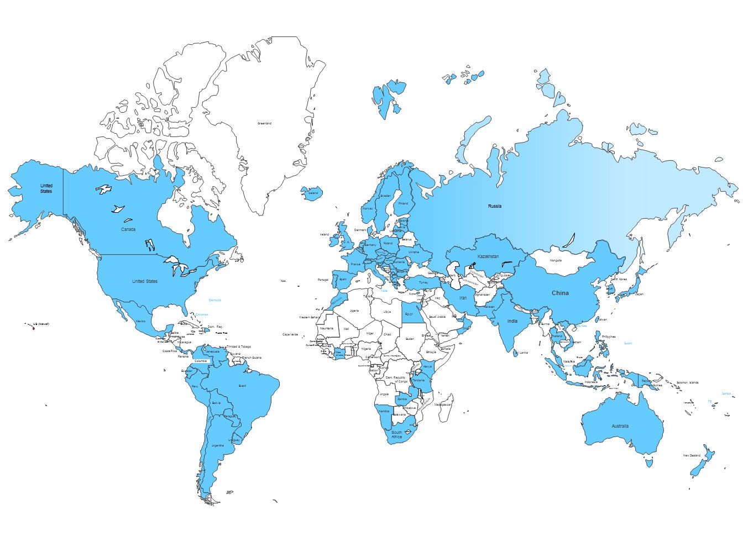
Six Systems to One
Notes:
You can see by the map that the USGA Handicap System is the primary system being used today around the world – but there are six systems representing 15 million golfers in 80 countries who currently maintain a golf handicap. Each system aims to achieve the same thing – measure a golfer’s ability and provide equity for play – but with differing results that don’t translate very well from one to the other. Handicapping is a fragmented market right now.
A collaborative process – USGA, R&A, Council of National Golf Unions (CONGU), European Golf Association, Golf Australia, Argentine Golf, South African Golf. Each of the existing handicap authorities have representation on the World Handicap Operations Committee. Along with the World Handicap Authority, they've helped developed the new World Handicap System.
Future landscape (2020) – click for animation:
A unified WHS will enable golfers of different ability to play and compete on a fair and equitable basis, in any format, on any course, anywhere around the world.
So it will be portable around the world and provide a single measure worldwide for determining a player’s ability.
When adopted, the World Handicap System will be governed by the USGA and The R&A and administered by national and multi-national associations around the world. Safeguards are included to ensure consistency as well as adaptability to differing golf cultures.

Slide 5
WHS took effect this morning.
New GHIN Handicap System went live this morning. This impacts:
Score Posting
Handicap Index Calculation
Golf Genius tournament software updated this morning to incorporate changes to Course Handicap calculations.
GHIN and AGA phone apps updated.
Current Handicap Index is the same your H.I. on December 15.
Your H.I. will be updated the morning after you post your first round in 2020.
Any rounds you have played since GHIN shut down on 12/31 should be posted as soon as you can.

Slide 6
Fundamentals of Handicapping

Slide 7
Key Definitions
ACCEPTABLE SCORE
A score from an authorized format of play which meets all the provisions set out in the Rules of Handicapping (see Rule 2).
The maximum score for a hole for handicap purposes, which is the sum of:
The Par of the hole,
Any handicap strokes applied on that hole, and
An additional two strokes
NET DOUBLE BOGEY
NET PAR
Net Par is the new term for Par Plus used when a hole is not played.
PLAYING CONDITIONS CALCULATION
A procedure used to evaluate if course and/or weather conditions on the day of play deviate from normal playing conditions to the extent that they have a significant impact on players’ performance.
PLAYING HANDICAP
Playing Handicap is the new term for a Course Handicap adjusted by a Handicap Allowance. Replaces the term “Adjusted Course Handicap.
Notes:
Cap
A reduction or limit on the increase of a player’s Handicap Index over a rolling 12-month period, measured against the player’s Low Handicap Index within that period of time. There are two forms of cap:
Soft cap – a reduction in the rate of upward movement of a Handicap Index
Hard cap – a maximum limit on the upward movement of a Handicap Index.
Playing Conditions Calculation (PCC)
A procedure used to evaluate if course and/or weather conditions on the day of play deviate from normal playing conditions to the extent that they have a significant impact on players’ performance.
Low Handicap Index
The lowest Handicap Index achieved by a player during the 12-month period preceding the most recent score on their scoring record (see Rule 5.7). This is used in the calculation to see if a cap must be applied.
Exceptional Score Reduction
A score differential which is at least 7.0 strokes better than the player’s Handicap Index at the time the round was played (see Rule 5.9).
Net Double Bogey
Replaces ESC and sets a maximum score for a hole based on the par and the strokes given or received.

Slide 8
More Key Definitions
LOW HANDICAP INDEX
The lowest Handicap Index achieved by a player within the last 12 months.
HARD AND SOFT CAP
A reduction or limit on the increase of a player’s Handicap Index over a rolling 12-month period, measured against the player’s Low Handicap Index within that period of time.
EXCEPTIONAL SCORE REDUCTION
A score differential which is at least 7.0 strokes better than the player’s Handicap Index at the time the round was played (see Rule 5.9).
Notes:
Cap
A reduction or limit on the increase of a player’s Handicap Index over a rolling 12-month period, measured against the player’s Low Handicap Index within that period of time. There are two forms of cap:
Soft cap – a reduction in the rate of upward movement of a Handicap Index
Hard cap – a maximum limit on the upward movement of a Handicap Index.
Playing Conditions Calculation (PCC)
A procedure used to evaluate if course and/or weather conditions on the day of play deviate from normal playing conditions to the extent that they have a significant impact on players’ performance.
Low Handicap Index
The lowest Handicap Index achieved by a player during the 12-month period preceding the most recent score on their scoring record (see Rule 5.7). This is used in the calculation to see if a cap must be applied.
Exceptional Score Reduction
A score differential which is at least 7.0 strokes better than the player’s Handicap Index at the time the round was played (see Rule 5.9).
Net Double Bogey
Replaces ESC and sets a maximum score for a hole based on the par and the strokes given or received.

Slide 9
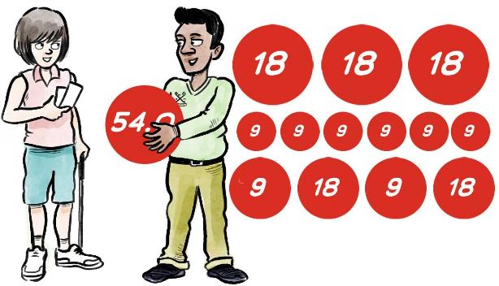
Minimum Scores to Obtain a Handicap Index
54 holes made up of any combination of 9 or 18-hole rounds.
No time limit on completing the submission of these scores.
Strong recommendation that initial scores are submitted hole-by-hole to better assess the potential of the player.
Notes:
Currently, the USGA Handicap System requires five 18-hole scores before a player can be issued a Handicap Index.
An overarching theme of the World Handicap System is to become more inclusive – and this feature will hopefully encourage golfers who only play sporadically to establish and maintain a Handicap Index.
It will be strongly recommended that a player’s initial three scores should be submitted hole-by-hole to enable clubs to better assess the player’s potential.

Slide 10
Maximum Handicap Index
The maximum Handicap Index that can be allocated to a golfer is 54.0.
This speaks to two key principles of the World Handicap System.
To be as inclusive and accessible as possible.
To make it as easy as possible for golfers to obtain and maintain a Handicap Index.
Note--Clubs may limit the maximum Handicap Index for their events.
Notes:
Although the current number of golfers in the U.S. that are at or above the current maximums of 36.4 and 40.4 is relatively small, many golfers who currently play but don’t have a handicap would be at or above those numbers
By encouraging more novice golfers to get a Handicap Index and learn about the WHS, we can incentivize golfers to improve their games and utilize pace of play provisions such as picking up at their maximum score.
It’s important to note that clubs will still have the discretion to implement a lower maximum limit for certain competitions through a condition of the competition. Committee’s will also be able to restrict Course/Playing Handicaps to 54.
Once again, this is in an effort to be more inclusive and welcoming to all golfers – and to increase the number of golfers with a Handicap Index.

Slide 11
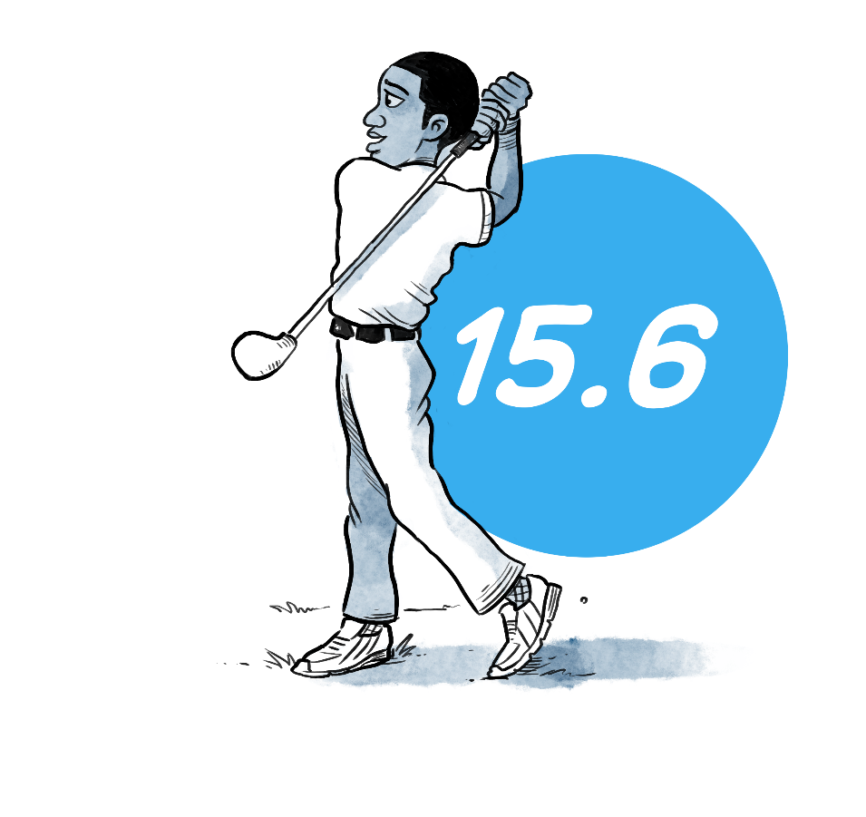
Course Handicap
Under the Rules of Handicapping, a Course Handicap will be the number of strokes a player receives to play down to the Par of the tees being played. The formula is:
15
Course Handicap =
(Handicap Index x Slope Rating / 113) + (CR – PAR)
Notes:
This is the most significant change for golfers in the U.S. Under the USGA Handicap System, Course Handicap represented the number of strokes needed to play to the Course Rating for the tees being played. The benchmark is now par, which may be intuitive to many, but will generate questions starting in January 2020 because golfers’ Course Handicaps will change as a result of the new calculation.
By applying a Course Rating minus Par adjustment, the process for setting up multi-tee events will be simplified – as this will eliminate the Section 3-5 adjustment. There is often confusion that comes along with the 3-5 adjustment, so this will be a welcomed change for many golfers out there.
AGAs will have the responsibility of adjudicating par – since par will be used in the Course Handicap calculation and impact the score posted for Net Double Bogey and Net Par.

Slide 12
+ (C.R – Par) Adjustment -- SaddleBrooke/Tucson Course
Men’s Tees
Women’s Tees
 | C.R. | Par | (CR–Par)
White | 68.8 | 72 | -3
White/Yellow | 67.9 | 72 | -4
Yellow | 66.6 | 72 | -5
Red | 64.7 | 72 | -7
 | C.R. | Par | (CR–Par)
Red | 69.2 | 72 | -3
Red/Aqua | 66.9 | 72 | -5
Aqua | 64.4 | 72 | -8

Slide 13
Course Handicap -- Examples
New Course Handicap (WHS) = Current CH + (C.R. – Par)
1. If Current CH is 10 & playing from M White or W. Red,
(C.R. – Par) is -3 and New CH = 7
2. If Current CH is 15 & playing from M White/Yellow,
(C.R. – Par) is -4 and New CH = 11
If Current CH is 20 & playing from M Yellow or W. Red/Aqua, (C.R. – Par) is -5 and New CH = 15
If Current CH is 25 & playing from W Aqua,
(C.R. –Par) is – 8 and New CH = 17

Slide 14
+ (C.R – Par) Adjustment -- SaddleBrooke/Tucson Course
Men’s Tees
Women’s Tees
 | C.R. | Par | (CR–Par)
White | 68.8 | 72 | -3
White/Yellow | 67.9 | 72 | -4
Yellow | 66.6 | 72 | -5
Red | 64.7 | 72 | -7
 | C.R. | Par | (CR–Par)
Red | 69.2 | 72 | -3
Red/Aqua | 66.9 | 72 | -5
Aqua | 64.4 | 72 | -8

Slide 15
Playing Handicap
When handicap allowances are used in various formats of play, Course Handicaps are adjusted to make the competition equitable.
Within the Rules of Handicapping, the adjusted Course Handicap will be referred to as a Playing Handicap.
13
15
=
x .85
Playing Handicap
=
Course Handicap x Handicap Allowance
Notes:
Note animation next to player: 15 x .85 = 13
There will need to be an adjustment when players compete from tees where Par is different – but this will happen much less frequently than players competing from tees with a different Course Rating.

Slide 16
Course Handicap (C.H.) vs. Playing Handicap (P.H.)
C.H.
P.H.

Slide 17
Recommended Handicap Allowances
Better Ball now 85% of Course Handicap for men & women,
vs. previous 90% for men and 95% for women.
Individual Play:
Field of 30+ players = 95%.
Field less than 30 players = 100%.

Slide 18
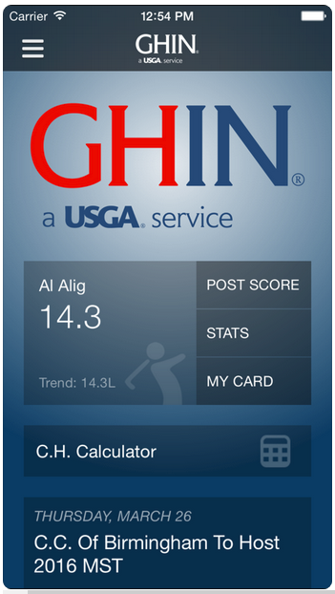
Score Posting
Acceptable Score

Slide 19
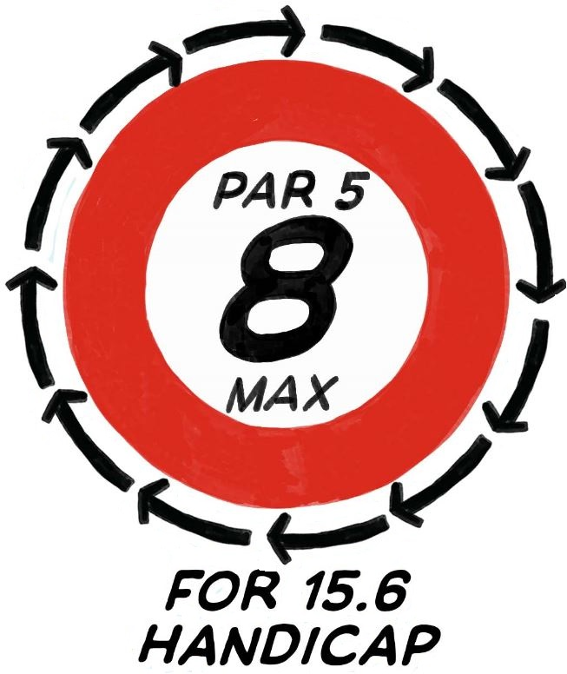
Maximum Score for Handicap Purposes
Net Double Bogey | A player’s maximum hole score for handicap purposes, ensuring bad holes don’t impact a player’s handicap too severely.
Notes:
This presents a significant change to golfers in the U.S., where we are moving from the current Equitable Stroke Control procedure to Net Double Bogey. The principle is the same, but the procedure is different.
While significant in the U.S., it is not a change for most of the rest of the world – because many parts of the world use Stableford scoring. Net Double Bogey is the equivalent to zero points in Net Stableford.

Slide 20
Maximum Score for Handicap Purposes
Net Double Bogey
=
Par
+
2
+/-
Handicap strokes received
or given on a hole
A player’s full, unrestricted Course Handicap is used to determine the number of handicap strokes for a net double bogey maximum hole score – not an adjusted Playing Handicap. See Rule 3.1b.
Notes:
Read through the example.

Slide 21
Maximum Score Example – Net Double Bogey
Based on full Course Handicap (Rule 3.1b)

Slide 22
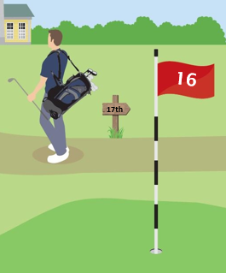
Hole Not Played
When a player does not play a hole, the score recorded for handicap purposes is net par.
For example:
A hole being declared out of play by the Committee for maintenance or reconstruction purposes.
Notes:
The procedure for posting a score for a hole not played remains the same with a new name. Par plus is now called net par.

Slide 23
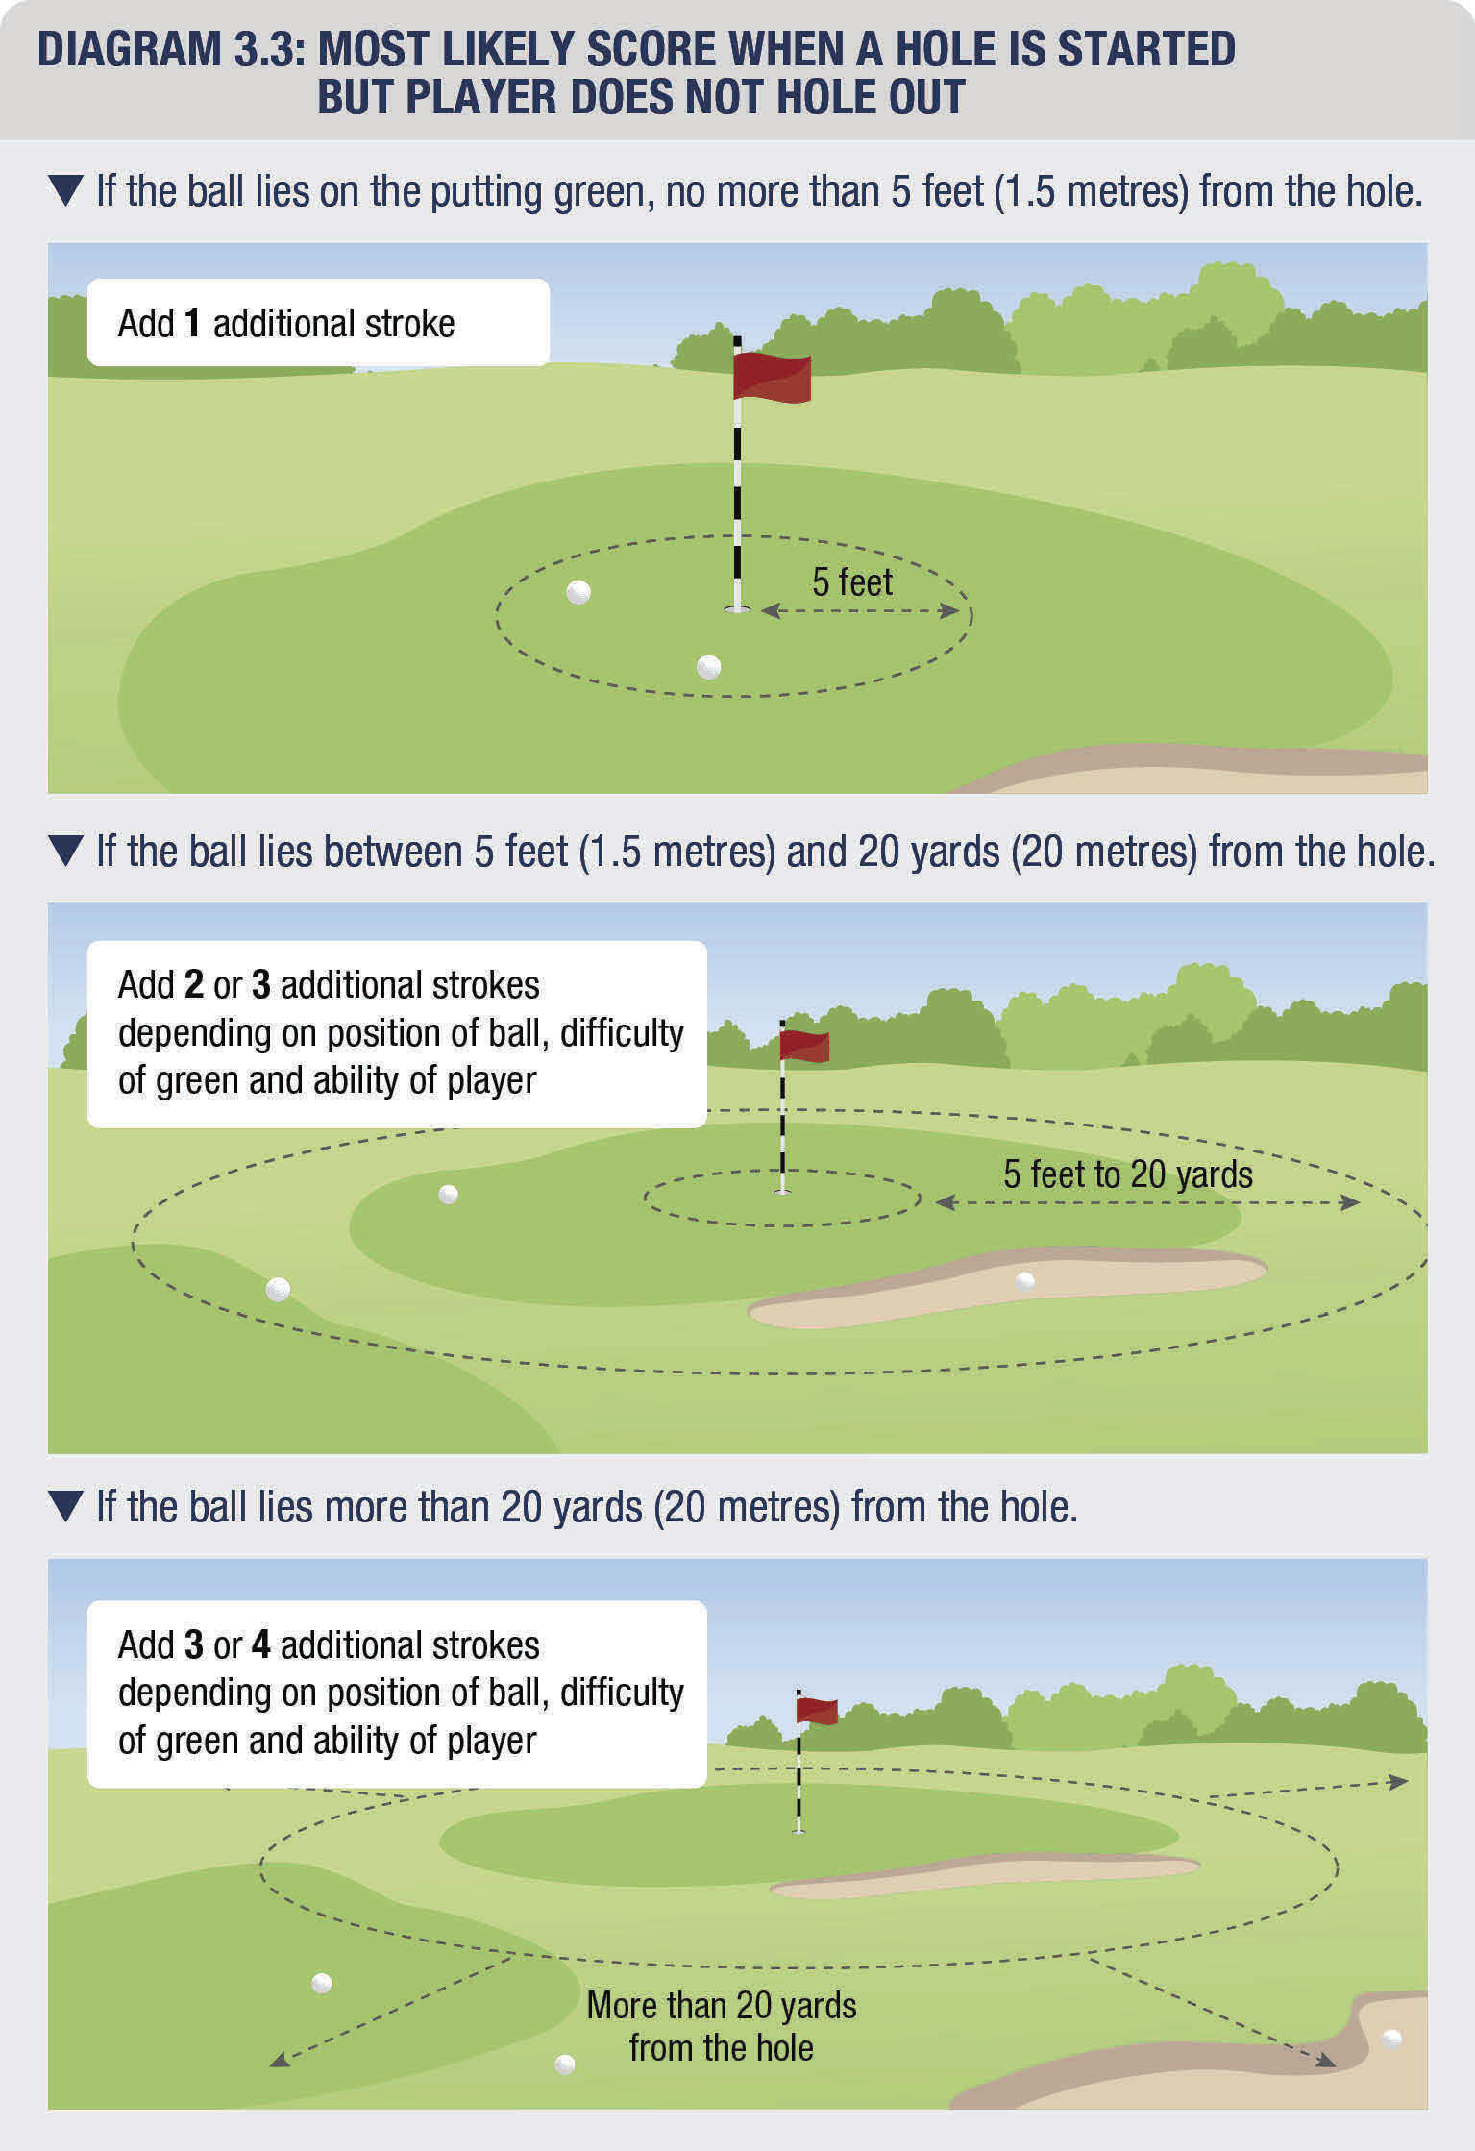
Most Likely Score
When you start, but do not finish a hole, the Most Likely Score is now based on the distance from the hole:
5 feet or less = 1 additional stroke.
Between 5 feet and 20 yards = 2 or 3 additional strokes.
More than 20 yards = 3 or 4 additional strokes.

Slide 24
Treatment of 9-Hole Scores
Combine two 9-hole scores to create an 18-hole score differential.
If a player plays 7 or more holes but fewer than 14, then a 9-hole score will be posted and then combined with the next 9-hole score.
9 + 9 =
18
Notes:
This does not present a change for golfers in the U.S.
Note that 9-hole scores are combined in the order they are received.
The minimum number of holes required for an 18-hole score will be 14, rather than the current number of 13 which presents minimal change.

Slide 25
Timeframe for Submitting a Score
A player should submit their score as soon as possible on the day of play and before midnight (local time).
If a player does not submit their score on the day of play, their score will not be included within the daily Playing Conditions Calculation.
When the score is subsequently posted to the player’s scoring record, the published playing conditions calculation for the day should be applied to the player’s score differential calculation.
Notes:
Emphasize the importance of posting as soon as possible after play. This will ensure the accuracy of a player’s Handicap Index on the next day and allow for the score to contribute to the data pool which determines if an adjustment for abnormal playing conditions should be made.
More on the Playing Conditions Calculation will be covered later in the presentation.

Slide 26
Importance of Same Day Posting

Slide 27
Questions?
QUESTIONS?

Slide 28
Handicap Index Formula

Slide 29
Handicap Index Calculation
There are five significant changes to the Handicap Index calculation coming in 2020:
1) The minimum number of scores required.
5) The addition of a Soft Cap and Hard Cap to limit upward movement.
3
2) The number of differentials used.
3) A Playing Conditions Calculation.
4) An Exceptional Score Reduction that considers all scores.
8
of
20
-1
Notes:
Overall, there are five significant changes to the Handicap Index calculation that you’ll see in 2020. We’ll get into each one individually, but keep in mind that the overall goal of the calculation is to be inclusive, modern and consistent – all while making the lives of handicap committees and golf administrators a little easier.
Minimum number of scores required to get a handicap – three 18-hole scores.
Using 8 differentials out of 20 the calculate the Handicap Index.
The introduction a Playing Conditions Calculation to account for variations in weather and course set up.
There’s a new Exceptional Score Reduction that looks at all posted scores.
Lastly, the introduction of a Soft Cap and Hard cap to limit extreme upward movement of a Handicap Index.

Slide 30
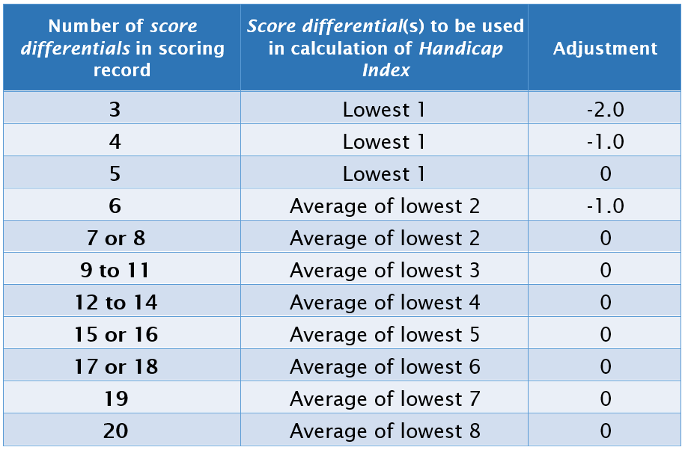
Number of Differentials Used
The following table will be used to determine the number of score differentials used in the Handicap Index calculation, as well as any additional adjustment:
Notes:
While we are being more inclusive to new golfers by reducing the minimal number of scores from 5 to 3, a third column was added that includes a downward adjustment. This happens when there are 3, 4, or 6 scores in a player’s scoring record. The adjustment reappears at 6 because that’s when an average of the lowest two scores is used.
This is done for a couple reasons:
First, with limited scoring information available, a downward adjustment is necessary to project the player’s ability. A player typically plays to their ability one out of every five rounds. When only three scores exist, it’s possible that the player hasn’t yet played to their potential. Second, the adjustment takes place as a safeguard. We’re using less data to calculate the player’s Handicap Index, so we want to be sure to protect the field whose handicaps are calculated using a more robust scoring record.

Slide 31
Calculation of a Score Differential
For an 18-hole Score, a Score Differential is calculated as follows:
Score Differential =
(113 / Slope Rating) X (Adjusted Gross Score – Course Rating – PCC adjustment)
Notes:
So how will a score differential be calculated under the WHS?
Many of the same parts are still used: Slope Rating, Adjusted Gross Score, Course Rating™, and the standard Slope Rating® of 113 – but the Playing Conditions Calculation has been included in the formula.
We’ll get into PCC in detail in a little bit – but if there is no PCC on a given day – the adjustment will be zero – and this should be the case on most days.

Slide 32
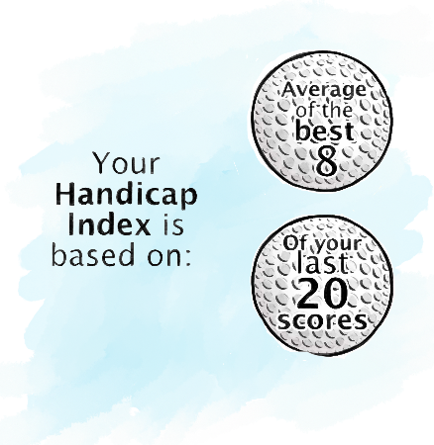
Calculation of a Handicap Index
For 20 Scores
Average the lowest 8 of the most recent 20 Score Differentials and round to the nearest tenth.
Notes:
We’ll be reducing the number of score differentials that are used in the handicap calculation – by moving from a 10 best out of 20 system that includes a 96% bonus for excellence to an 8 best of 20 system in 2020.
An 8 of 20 system, which rounds to the nearest tenth, will allow for greater responsiveness to good scores and will eliminate the need for a bonus for excellence– which is often difficult to explain and confuses people on how the calculation works. Considering higher handicap players typically have more fluctuation within their scoring records, using 8 of 20 will allow their best scores to weigh more heavily and create for more equity throughout the full range of handicaps.

Slide 33
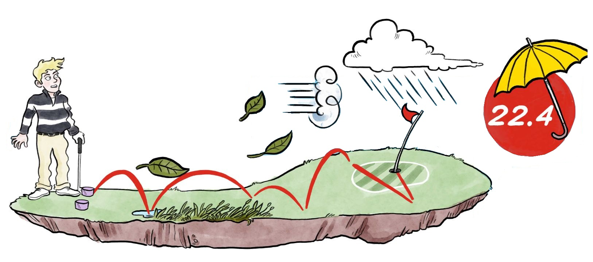
Playing Conditions Calculation
When adverse weather conditions or abnormal course set-up causes scores to be unusually high or low on a given day, a Playing Conditions Calculation will adjust Score Differentials to better reflect the player’s actual performance.
The ‘PCC’ will be simple and conservative in nature and will be adjusted in integer values.
Range: -1 to +3
Notes:
Golf is an outdoor sport, and sometimes playing conditions can cause scores to be abnormally high or low on a given day. A score of 80 on a rainy, windy day or on a day where the course is set up more difficult than normal may be more impressive than a 79 on a calm day with normal course conditions.
The PCC will account for this and adjust Score Differentials to better reflect the player’s actual performance. Any adjustment will be clearly identified in the player’s scoring record for transparency. As noted on the slide, adjustments will be applied conservatively and will be in integer values; you won’t see an adjustment of +1.45.
The calculation will be automatic through the computation service. Also, the calculation will be purely data driven. The more posted scores which are above or below what is expected based on Course/Slope Ratings and Handicap Index of players, the more likely an adjustment will take place.
This feature is one of the more modern features of the system.

Slide 35
Exceptional Score Reduction
ESR is a procedure for dealing with exceptional scores which may indicate the player’s true ability. The procedure considers all scores, rather than only Tournament scores.
How does it work?
Calculate Score Differential once score is posted and Playing Conditions Calculation is applied (when appropriate).
Calculate new Handicap Index.
If Score Differential is -7.0 strokes or better than the Handicap Index from when the round was played, apply ESR table reduction to new Handicap Index:
Score Differential Relative to Index | 7.0 – 9.9 strokes lower | 10.0 + strokes lower
ESR Adjustment | -1.0 | -2.0
This is in addition to any reduction caused by the score being used in the updated 8 of 20 calculation.
Notes:
The Exceptional Score Reduction (ESR) is a procedure that will essentially replace the current 10-3 reduction process and will simplify the automatic reduction altogether.
ESR considers all scores, rather than just tournament scores, so that any time a player demonstrates ability that is significantly better than their Index suggests, a simple automatic adjustment is made.
If a player posts a score that produces a Score Differential 7.0 strokes or better than their Handicap Index at the time the score was submitted, an automatic adjustment is made using the displayed table.
When an Exceptional Score is posted, a -1 or -2 adjustment will be applied to each of the previous 20 Score Differentials in a player’s scoring record. The net result will be a 1.0 or 2.0 stroke reduction in their Handicap Index. Also note that, while not expected to be common, multiple ESR adjustments in the scoring record will be cumulative.
Subsequent scores posted will not contain the -1 or -2 adjustment, which allows the impact of the ESR to diminish as new scores are posted.

Slide 37
Memory of Low Handicap Index
The Low Handicap Index represents the demonstrated ability of a player over the 12-month period preceding the most recent score in the player’s scoring record and provides a reference point against which the current Handicap Index can be compared.
Notes:
A Low Handicap Index is established once a player has at least 20 acceptable scores in their scoring record. It is re-evaluated every time a new acceptable score is submitted.
Where a Committee applied adjustment increases the Handicap Index, the Low Handicap Index should be set at that level to prevent the golfer from receiving a soft or hard cap which will be covered shortly.
Where a Committee applied adjustment reduces a player’s Handicap Index, the adjusted Handicap Index resets the Low Handicap Index at that level unless a lower Handicap Index is still eligible.
A player’s scoring record must display their Low Handicap Index.

Slide 38
Cap Procedure
A Soft Cap and Hard Cap will be implemented to limit the extreme upward movement of a player’s Handicap Index within a 365-day (one year) period.
The Soft Cap will suppress upward movement by 50% after a 3.0 stroke increase over the Low Handicap Index has been reached.
The Hard Cap will restrict upward movement to 5.0 strokes over the Low Handicap Index.
The soft cap and hard cap procedures only start to take effect once a player has at least 20 acceptable scores in their scoring record.
Notes:
The soft cap and hard cap will be implemented to ensure that a temporary loss of form does not cause a player’s Handicap Index to move too far from a level consistent with their demonstrated ability; i.e. their Low Handicap Index.
The caps also serve as anti-abuse safeguards and will aid in minimizing the potential for handicap manipulation. The Handicap Committee at the club will still play a key role and have the ability to allow a player’s Handicap Index to exceed the hard cap if special circumstances such as an injury exist.

Slide 40
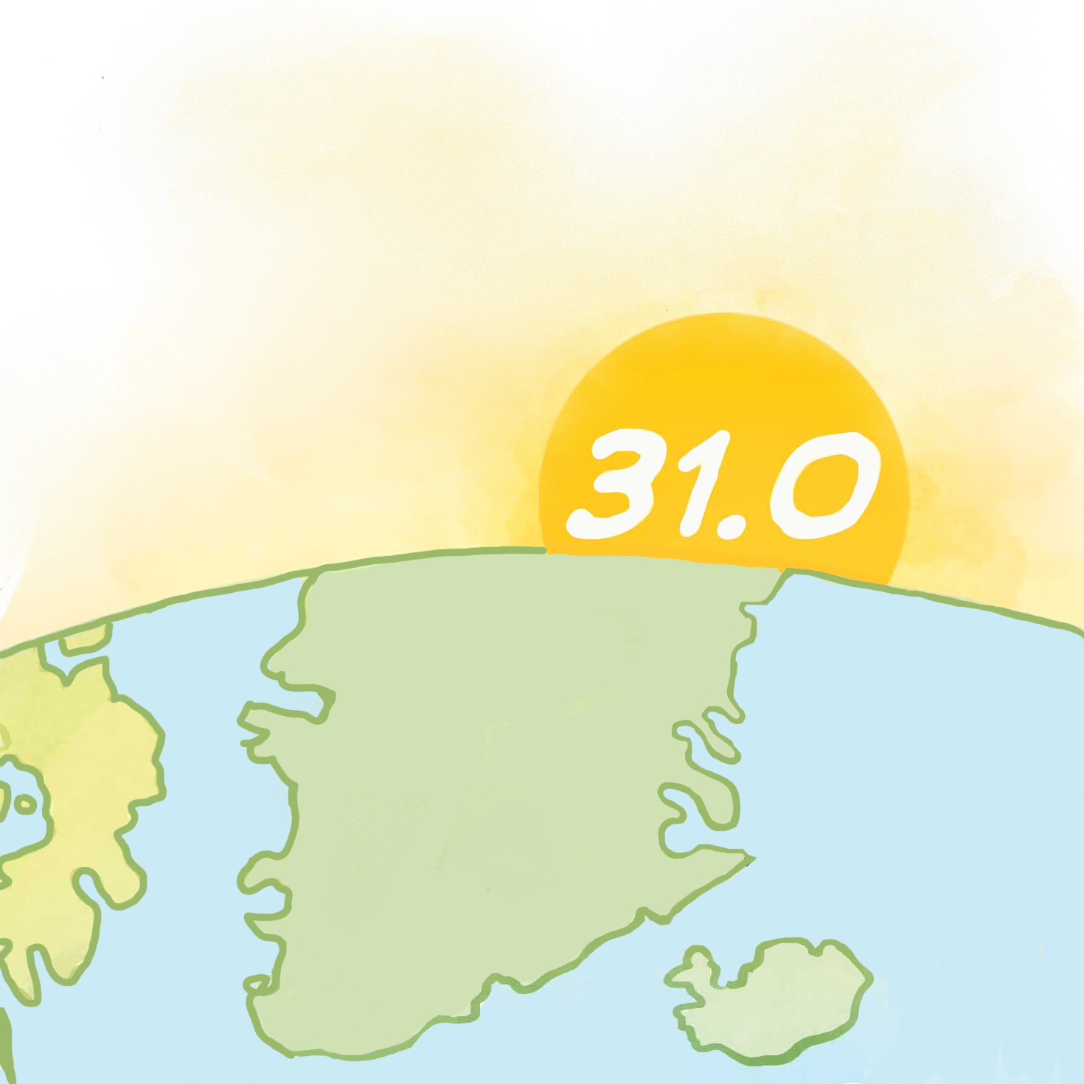
Daily Revisions
Under the Rules of Handicapping, a Handicap Index will update the day after a score(s) is posted.
Players should submit their scores as soon as possible after the round is completed, and before midnight.
This is to ensure the score will be used in the Playing Conditions Calculation.
A player’s Handicap Index can also be revised by a Committee adjustment.
Notes:
It’s referred to as daily revisions – but we want to make it clear that a revision only takes place after a day where a player posts a score, or a Committee adjustment was applied.
Revisions will take place at midnight following the submission of a score.
This is not a real-time revision. In other words, if someone plays twice in one day, their Handicap Index will still only update once on the following day.

Slide 41
Handicap Review
It is strongly recommended that the Handicap Committee conducts a handicap review at least once a year, for all players for which it is responsible.
WHS compliant technology should provide reports to assist Handicap Committees identify those players requiring a handicap review.
A player can request a handicap review if they believe their Handicap Index no longer reflects their demonstrated ability.
A player must be made aware of, and be involved in, the handicap review process and be able to appeal a decision.

Slide 42
Handicap Committee Responsibilities

Slide 43
Adjusting a Handicap Index
The Handicap Committee can adjust a player’s Handicap Index to ensure that it reflects their demonstrated ability. In doing so, the Handicap Committee should consider all available information relating to the player’s demonstrated ability, including:
The player’s scoring potential,
Any handicap(s) previously held by the player, and
Whether the player is an improver, a steady player or a declining player.
The Handicap Committee should consult with, or have ratified, any player’s handicap adjustment by the Allied Golf Association.

Slide 44
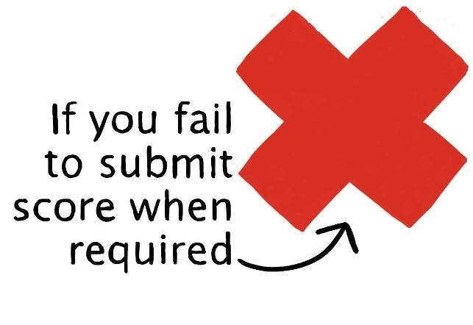
Applying a Penalty Score
If a player fails to submit a score from an authorized format of play in a timely manner, the Handicap Committee should investigate and take appropriate action.
If the reason was valid and an acceptable score is still discoverable, that score will be posted.
If there was no valid reason and an acceptable score is discoverable, that score will be posted and a penalty score may be posted.
If the score is not discoverable, a penalty score may be posted.
In the most serious cases, such as repeated failure to submit acceptable scores, the Committee has discretion to apply additional penalty scores, reset the player’s Handicap Index or consider other disciplinary procedures.
Notes:
This is not change for golf clubs or golfers in the U.S. Penalty scores can either be equal to the highest or lowest score differential in the scoring record, determined by the Handicap Committee and on a case-by-case basis.

Slide 45
Competition Committee Responsibilities
Notes:
We’ll now go through the role of the Committee in charge of the competition.

Slide 46
Competition Committee
The Committee in charge of a competition may set a maximum limit for play within their Terms of the Competition.
For example:
A maximum Handicap Index for entry.
A maximum Handicap Index a player is permitted to use.
A maximum Course Handicap.
A maximum Playing Handicap.
Notes:
The Competition Committee determines who is eligible to compete as well as the handicap a player may use for their event.

Slide 47
Questions?
QUESTIONS?

Slide 48
Thank you for attending!
Notes:
Please use this closing slide if you do not plan to co-brand it.

